Slide 1



2: Kalpna Mishra
Object-Oriented Programming Methodology Case Study
Banking System
Phase 2
Team: HelloWorld
Team Members:
Vishwasjeet Kr Gupta (Leader- 0131CS221225)
Sunil Rathore (0131CS221208)
Ram Vinay Kumar (LE)
Vivek Agarwal (0131CS221226)
Mentor 2: Kalpana M.
Mentor 1: Dr A. Pathre
Department of Computer Science and Engineering

Slide 2


Object-Oriented Programming Methodology Case Study- Banking System
Contents:
Summary of First Phase
Class -Object Diagram
Brief of Use Class Diagram
Use-Case Diagram
Brief Of Use-Case Diagram

Slide 3


Object-Oriented Programming Methodology Case Study - Banking System
Brief Of First Phase
Objective
Studies
Input-Output Analysis
In the first phase, we presented our proposal for this case study. We found our objectives to create a class for customers and banks and perform the different transactions to check balance, deposit cash, withdraw cash, and transfer money. We proposed to create an easy to use and unique system.
We studied the best banking system applications available in the market. We observed all the pros and cons of those software and through our case study, we are proposing our system with some unique features which are not there in these existing applications.
We analyzed all the input and output requirements of a banking system. As banking service requires users’ confidential data, we need to keep it safe and secure. The user’s credentials should be verified before any transaction because unauthorized transactions may lead to fraud.

Slide 4


Object-Oriented Programming Methodology Case Study - Banking System
Class-Object Diagram
Bank
NewUser
- string bank_name - string bank_IFSC - string bank_address
ExistingUser
- string cName - string cAge - string cMob
- string cDob - string cPinCode - string cAddress
- string cID
- string regdAccNo - string regdPswd - string regdPIN
- string regd_IDNo
+ welcomeMessage()
+ userTypeMenu()
+ getRegdAccDetails()
+ getPIN()
Authentication
+ getPersonalDetails()
- int regdaccountCheck[14]
- string regdPswdCheck
- int regdPINCheck[6] - int regd_IDNoCheck[12] - int transferAccountCheck[20]
RegisterAccount
Transactions
- string accountNum
- string loginPassword
- string securityPIN
+ int choice
# float balance
- float amount, transferCharge
+getAuthenticationDetails()
+getTransferAccDetails()
+ doAuthentication()
+ generateAccount()
- getMobNoPart()
- getDobPart()
- getAgePart()
- getPinCodePart()
+ balanceInquiry()
+ cashDeposit()
+ cashWithdrawl()
+ transferSameBank
+transferOtherBank
+calculateTransCharge
BankDatabase
- int NumOfTransaction
- float monthlyMaintainCharge
+ calculateMonthlyCharge()
friend updateBalance()
friend printAllTransactions()

Slide 5

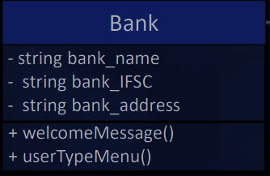
Object Oriented Programming Methodology Case Study - Banking System
Brief of Class Object Diagram
Bank class
The Bank class stores the details of the bank like the bank’s name, IFSC code, and Address. It has three data members and two member functions. Data members are kept private to ensure security and unauthorized access.
Data member bank_name stores the name of the bank, bank_IFSC stores the IFSC Code, and bank_address stores the address of the bank.
Member function welcomeMessage() displays the welcome screen and front page and the member function userTypeMenu() displays the first menu to select the user type.

Slide 6
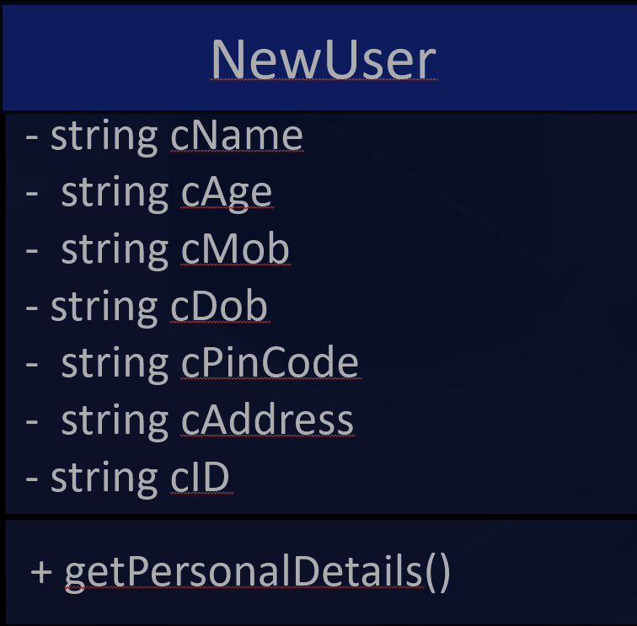
Object Oriented Programming Methodology Case Study - Banking System
Brief of Class Object Diagram
NewUser class
The NewUser class takes the user details as input and stores it through private data members. It has seven data members and one member function.
- string cName : User’s name - string cAge : User’s Age - string cMob : User’s mobile number
- string cDob : User’s Date of birth - string cPinCode : User’s PIN code - string cAddress : User’s Address
- string cID : User’s Identity card number
Member function +getPersonalDetails() - Takes input from the users and stores it in private data members that are already declared.

Slide 7
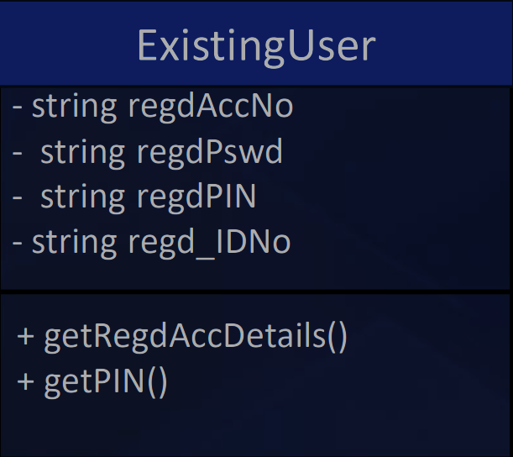
Object Oriented Programming Methodology Case Study - Banking System
Brief of Class Object Diagram
ExistingUser
The ExistingUser class will act for the registered user. It is inherited from the bank class and it has four data members and two member functions member function.
- string regdAccNo : Registered User Account Number - string regdPswd : Registered User Login Password - string regdPIN : Registered User PIN
- string regd_IDNo : Registered User Identity Card Number
Member function +getRegdAccDetails() Takes input from the registered users and stores it in private data members. These data will be used in the authentication process in the child class.
+getPIN() function will take the transaction PIN from the user.

Slide 8
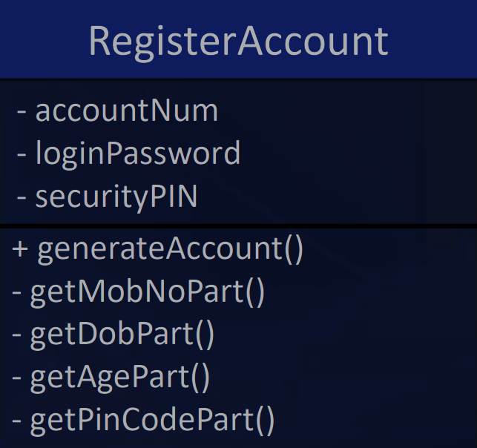
Object Oriented Programming Methodology Case Study - Banking System
Brief of Class Object Diagram
RegisterAccount
The RegisterAccount class will act for the new user. It is inherited from the NewUser class. This class will be used to open a new bank account. It has three data members and fifteen member functions member function.
- string accountNum : Generated account number
- string loginPassword : Password created by user
- string securityPIN : Transaction PIN created by user
Member Functions
+ generateAccount() : To generate an account number for the new user.
- getMobNoPart()
- getDobPart()
- getAgePart()
- getPinCodePart()
To get combination of digits for generating a unique Account number.

Slide 9
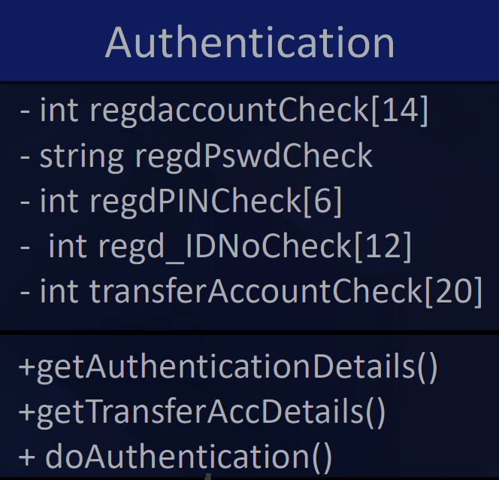
Object Oriented Programming Methodology Case Study - Banking System
Brief of Class Object Diagram
Authentication
The Authentication class will act for both type of users . It has two parent classes , RegisterAcccount and ExitsingUser.
- int regdaccountCheck[14] : Account number for authentication.
- string regdPswdCheck : Password for Authentication.
- int regdPINCheck[6] : Transaction Pin for Authentication. - int regd_IDNoCheck[12] : Identity card number for Authentication. - int transferAccountCheck[20] : Account number Authentication for money transfer .
Member Function :
+getAuthenticationDetails() : Get details from the user for Authentication
+getTransferAccDetails() : Get Account details for money transfer.
+ doAuthentication() : To verify all the given details.

Slide 10
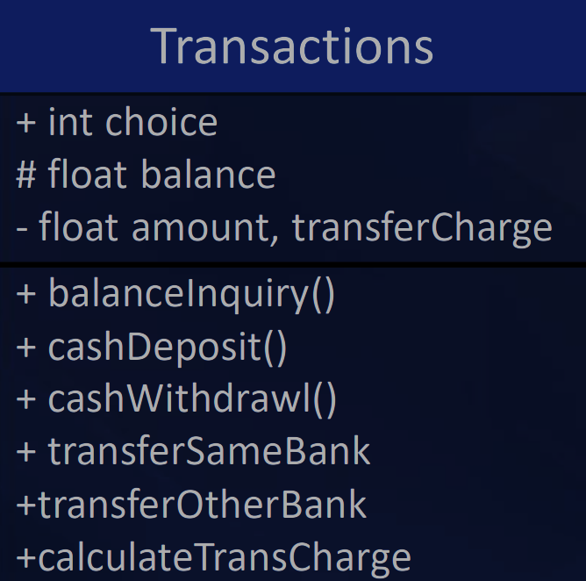
Object Oriented Programming Methodology Case Study - Banking System
Brief of Class Object Diagram
Transactions
The Transactions class will act for both types of users. It is inherited from the Authentication class. This class will be used to perform all the transactions for the users. It has Four data members and Six member functions.
+ int choice : selecting the option from the list of services.
# float balance : Account opening balance.
- float amount : Transaction amount for Deposit, Withdrawal, and Transfer.
- transferCharge : Calculated transfer charge.
Member Function :
+ balanceInquiry() : To check account balance.
+ cashDeposit() : To deposit cash.
+ cashWithdrawl() : To withdraw cash.
+ transferSameBank : To transfer money to same bank.
+transferOtherBank : To transfer money to other bank .
+calculateTransCharge : To calculate transfer charges.

Slide 11
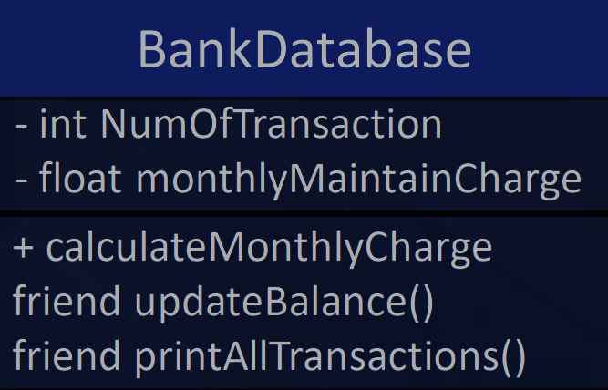
Object Oriented Programming Methodology Case Study - Banking System
Brief of Class Object Diagram
BankDatabase
The BankDatabase class holds all the data of the user securely and it has attributes to keep the record of transactions. It has two data member and three member function.
- int NumOfTransaction : Store number of transactions.
- float monthlyMaintainCharge : Monthly maintenance charge for users.
Member function :
+ calculateMonthlyCharge : To calculate monthly charges.
friend updateBalance() :To update user’s account balance.
friend printAllTransactions() : To print all transaction details.
()

Slide 12


Object-Oriented Programming Methodology Case Study - Banking System
Use-Case Diagram
Login / Open Account
Balance Inquiry
Authentication
Show Transaction History
Deposit Cash
User
Withdraw Cash
Update Balance
Bank databases
Transfer
Cashier
Same
Bank
Different Bank
Calculate Charge

Slide 13

Object Oriented Programming Methodology Case Study - Banking System
Input-Output Flow
Option 1:New User
Front Page
Thank you for your interest in our bank.
Please fill the form given below to open your account :
1. Your Good Name: Rahul Kumar
2. DOB(DD-MM-YYYY): 02-03-2000
3. Mob No.: 9131555689
4. ID card No: 5678 4589 9590
(Aadhar/ Voter Id)
5. PAN: CUAPG035M
6. Age: 23
7. Address: Sector A, Indrapuri
8. PIN Code: 465647
Your Account is successfully created and your unique account number is generated:
A/c No.: 57020368923647
Please create your login password and transaction PIN to complete the account opening process:
Login Password: Rk0203@590
(min 8 char max 12)
PIN(6Digits): 689547
Congratulations your account is registered with us with the following details:
Name: Rahul Kumar
A/c No.: 57020368923647
IFSC: IBL005710
DOB: 02-03-2000
Mob No.: 9131555689
User Name: rk68935m
Address: Sector A, Indrapuri,
Pin-465647
India Bank Limited
Hello Sir/Madam
Please select the option from the following menu to proceed:
New User
Existing User

Slide 14
Object Oriented Programming Methodology Case Study - Banking System
Input-Output Flow
Option 2:Existing User/New User After Account Opening
Welcome back Mr/Mrs. Rahul Kumar
Thank you for logging in, your registered details are:
Name: Rahul Kumar
A/c No.: 57020368923647
IFSC: IBL005710
DOB: 02-03-2000
Mob No.: 9131555689
Address: Sector A, Indrapuri,
Pin-465647
Please login with your credentials to proceed:
User Name: rk68935m
Password: Rk0203@590
Authenticating…
Login Successful
You can proceed now…

Slide 15
Object Oriented Programming Methodology Case Study - Banking System
Input-Output Flow
Service Menu
Choose the services needed:
1. Check Balance
2. Deposit Cash
3. Withdrawal Cash
4. Transfer money to the same bank
5. Transfer money to another Bank
6. Exit
Enter your choice: 1
Available Balance: 0
Choose the services needed:
1. Check Balance
2. Deposit Cash
3. Withdrawal Cash
4. Transfer money to same the bank
5. Transfer money to other Bank
6. Exit
Enter your choice: 2
Enter Amount: 50000
Cash Deposit Successful
Available Balance: 50000
Choose the services needed:
1. Check Balance
2. Deposit Cash
3. Withdrawal Cash
4. Transfer money to the same bank
5. Transfer money to the other Bank
6. Exit
Enter your choice: 3
Enter Amount: 10000
Enter PIN: 689547
Cash Withdrawal Successful
Available Balance: 40000
Choose the services needed:
1. Check Balance
2. Deposit Cash
3. Withdrawal Cash
4. Transfer money to the same bank
5. Transfer to the other Bank(Charges applied)
6. Exit
Enter your choice: 4
Enter Amount: 5000
Enter PIN: 689547
Money Transfer Successful
Available Balance: 35000
Choose the services needed:
1. Check Balance
2. Deposit Cash
3. Withdrawal Cash
4. Transfer money to the same bank
5. Transfer to the other Bank (Charges applied)
6. Exit
Enter your choice: 5
Enter Amount: 10000
Enter PIN: 689547
Money Transfer Successful
Charge Deducted: ₹5
Available Balance: 24995

Slide 16
Object Oriented Programming Methodology Case Study - Banking System
Input-Output Flow
Transaction History
Your Transaction Details:
Date Transaction Type Amount Charge Balance
1. 05/12/2023 Deposit 50000 0 50000
2. 05/12/2023 Withdrawal 10000 0 40000
3. 05/12/2023 Transfer 5000 0 35000
4. 05/12/2023 Transfer(other bank) 10000 5 24995
Account Summary:
Name: Rahul Kumar
A/c No.: 57020368923647
IFSC: IBL005710
Maintenance Charge: 0
Total Balance: 24995

Slide 17






Object Oriented Programming Methodology Case Study - Banking System
Team: HelloWorld
Vishwasjeet Kr Gupta
Sunil Rathore
Ram Vinay
Vivek Agrawal
(0131CS221225) (Team Leader)
(0131CS221208) (Team Member)
(LE) (Team Member)
(0131CS221226) (Team Member)

